Slide 1


AI VIRTUAL MOUSE
JOMIN K MATHEW
MCA421

Slide 2

CONTENTS
Introduction
Related Work
Gap Identified
Problem Statement
Objectives
Methodology
Conclusion
Future Work
Output
References

Slide 3

Introduction
AI virtual mouse system that makes use of the hand gestures and hand tip detection for performing mouse functions in the computer using computer vision.
The main objective of this system is to perform computer mouse cursor functions and scroll function using a web camera or a built-in camera in the computer instead of using a traditional mouse device.
In this system, the web camera captures and then processes the frames that have been captured and then recognizes the various hand gestures and hand tip gestures and then performs the particular mouse function.
Python programming language is used for developing the AI virtual mouse system.

Slide 4
Related Work
Sl no | Title with Publisher | Year of Publisher | Pros | Cons
1 | S.Shriram, B.Nagaraj, J. Jaya , S. Shankar and P. Ajay – “Deep Learning-Based Real-Time AI Virtual Mouse System Using Computer Vision to Avoid COVID-19 Spread”, Hindawi, IEEE, Conference on Aerospace and Electronics, vol. 2, pp. 755–760,1990. | 2021 | Perform most of the mouse functions such as left click, right click and also, the model is helpful in controlling the PC like a physical mouse. | Only few mouse functions are performed.
2 | Chaithanya C, Lisho Tomas, Naveen Wilson, and Abhilash SS - “Virtual Mouse Using Hand Gesture”, IEEE, International Research Journal of Engineering and Technology (IRJET, vol. 5,no. 4, 2018. | 2018 | The model detection is based on colors. | Difficult to perform some gestures, Only few mouse functions are performed.

Slide 5

Sl no | Title with Publisher | Year of publisher | Pros | Cons
3 | Vinay Kr. Pasi, Saurabh Singh, and Pooja Kumari - “Cursor Control using Hand Gestures”, IJCA Journal IEEE. | 2016 | Perform different functions of the mouse. | It depends on various colors to perform mouse functions.
4 | Monika B. Gandhi, Sneha U. Dudhane, and Ashwini M. Patil - “Cursor Control System Using Hand Gesture Recognition”, International Journal for Research in Applied Science and Engineering Technology (IJRASET), IEEE. | 2013 | Recognize the hand gestures and control the computer/laptop according to those gestures. | Stored frames are needed to be processed for hand segmentation and skin pixel detection
5 | Dung-Hua Liou, ChenChiung Hsieh, and David Lee – “A Real-Time Hand Gesture Recognition System Using Motion History Image”, IEEE. | 2010 | Adaptive skin color model and motion history image. | Complicated hand gestures
6 | Quam(Data Glow),”Hardware based system”. | 1990 | Higher accuracy | Difficult to perform some of the gesture controls using the system.

Slide 6
Gap Identified
Stored frames are needed to be processed for hand segmentation and skin pixel detection.
Difficult to perform some of the gesture controls using the system.
Complicated hand gestures.
Only few mouse functions are performed.

Slide 7
Problem Statements
The MediaPipe Framework is used for tracking the hands and tip of the hands so, stored frames are not needed to be processed for hand segmentation and skin pixel detection. It is easy to perform the gesture controls using the system, Simple hand gestures are used, More mouse functions are added.

Slide 8
Objective
The main objective of AI virtual mouse system is to develop an alternative to the regular and traditional mouse system to perform and control the mouse functions.
This can be achieved with the help of a web camera that captures the hand gestures and hand tip.
Then processes these frames to perform the particular mouse function such as left click, right click, and scrolling function.

Slide 9
Methodology
Architecture
AI Virtual System
Recognizing different hand movements
Performing different mouse functions.

Slide 10
Flow chart
Initialize the system and start the video capturing of WEBCAM.
If both Index and middle Fingers are up.
Mouse Cursor moving around the Window.
Capture frames using WEBCAM.
If Index finger down and middle Finger are up.
Perform Left Button Click.
Detect Hands and Hand Tips using MediaPipe and OpenCV.
If Index finger up and middle Finger are down.
Perform Right Button Click.
Detect which finger is UP.
If both index and middle fingers up and close each other.
Perform Double Click..

Slide 11
Some more mouse functions
Initialize the system and start the video capturing of WEBCAM.
If both thumb and index Fingers close each other (left hand) move up and down.
Perform Scroll up and down Function.
Capture frames using WEBCAM.
If both thumb and index Fingers close each other (Right hand), move left and right.
Perform Brightness up and down Function.
Detect Hands and Hand Tips using MediaPipe and OpenCV.
If all the Five Fingers Are closed.
Detect which finger is UP.
Perform Copy Function
If all the Five Fingers Are up.
No action is performed.

Slide 12
Tools used for Ai Virtual Mouse system.
Python programming language is used for developing the AI virtual mouse system.
OpenCV which is the library for computer vision is used in the AI virtual mouse system.
The MediaPipe Framework for tracking of the hands and for tracking the tip of the hands.
PyAutoGUI package were used for moving around the window screen of the computer for performing functions such as left click, right click and scrolling functions.

Slide 13
The Camera Used in the AI Virtual Mouse System.
The AI virtual mouse system is based on the frames that have been captured by the webcam in a laptop or PC. By using the Python computer vision library OpenCV, the video capture object is created and the web camera will start capturing video. The web camera captures and passes the frames to the AI virtual system.
Capturing the Video and Processing.
The AI virtual mouse system uses the webcam where each frame is captured till the termination of the program. The video frames are processed from BGR to RGB color space to find the hands in the video frame.

Slide 14
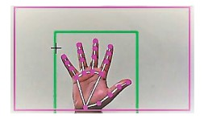
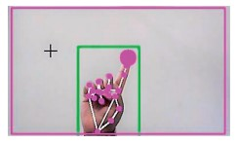
Rectangular Region for Moving through the Window.
The AI virtual mouse system converts the coordinates of fingertip from the webcam screen to the computer window full screen for controlling the mouse.
Detecting Which Finger Is Up and Performing the Particular Mouse Function.
In this stage, we are detecting which finger is up using the tip Id of the respective finger that we found using the MediaPipe and the respective co- ordinates of the fingers that are up and according to that, the particular mouse function is performed.

Slide 15
Conclusion
AI virtual mouse system is to control the mouse cursor functions by using the hand gestures instead of using a physical mouse. The system can be achieved by using a webcam or a built-in camera which detects the hand gestures and hand tip and processes these frames to perform the particular mouse functions accurately and fastly.

Slide 16
Future work
Develop to handle the keyboard functionalities along with the mouse functionalities virtually.

Slide 17
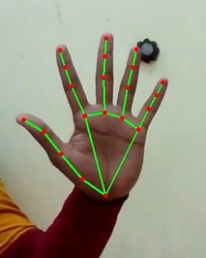
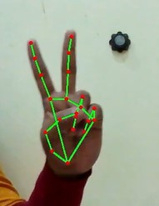
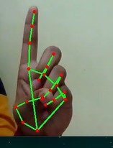
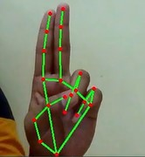
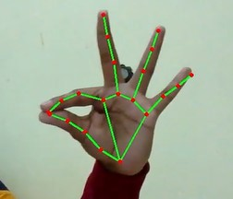
Output

Slide 18
References
D. L. Quam, “Gesture recognition with a DataGlove,” IEEE Conference on Aerospace and Electronics, vol. 2, pp. 755–760,1990.
L. Tomas, “Virtual mouse using hand gesture,” International Research Journal of Engineering and Technology (IRJET, vol. 5,no. 4, 2018.
J. Katona, “A review of human–computer interaction and virtual reality research fields in cognitive InfoCommunica-tions,” Applied Sciences, vol. 11, no. 6, p. 2646, 2021.
https://www.tutorialspoint.com/opencv/index.html

Slide 19

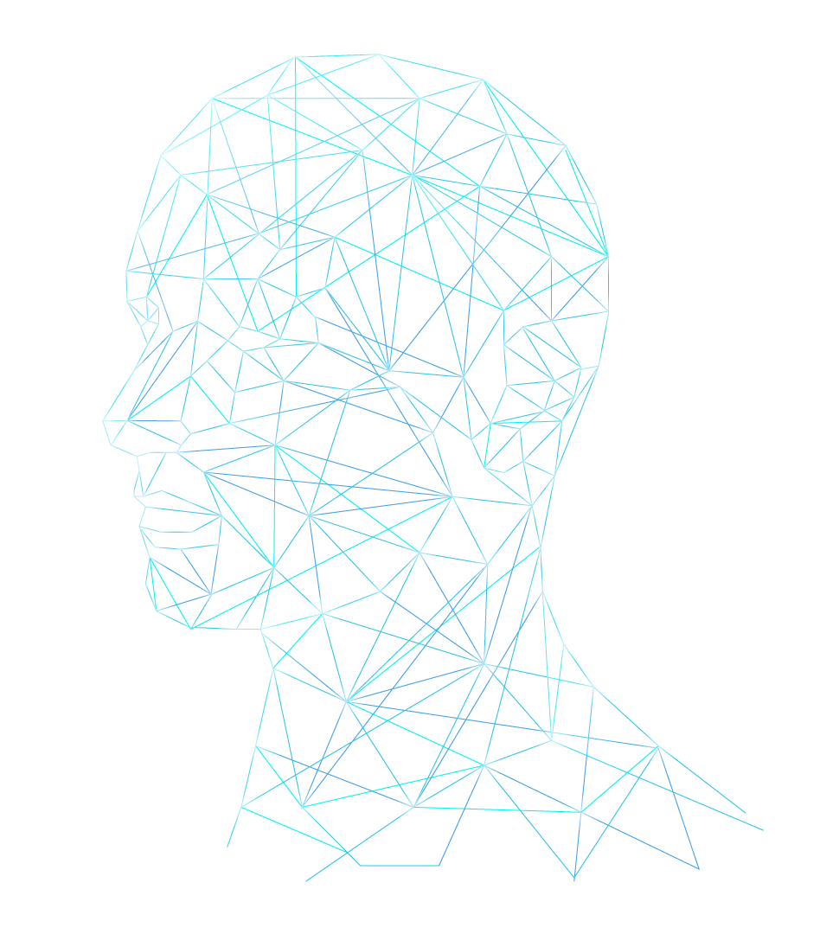
THANK YOU!

